Slide 1
Python Programming – I (Introduction)
- By Nimesh Kumar Dagur, CDAC Noida, India

Slide 2
Introduction to Python programming
Python is a widely used general-purpose, high-level programming language.
Its design philosophy emphasizes code readability, and its syntax allows programmers to express concepts in fewer lines of code than would be possible in languages such as C.
Python supports multiple programming paradigms, including object-oriented and functional programming or procedural styles.
Python was developed by Guido van Rossum in the late eighties and early nineties at the National Research Institute for Mathematics and Computer Science in the Netherlands.

Slide 3
Introduction to Python programming
Python is Interpreted
Python is Interactive
Python is Object-Oriented
Python is Beginner's Language

Slide 4
Python's feature
Easy-to-learn: relatively few keywords, simple structure, and a clearly defined syntax
Easy-to-read: much more clearly defined and visible to the eyes
Easy-to-maintain: source code is fairly easy-to-maintain. (Module & package)
A broad standard library: bulk of the library is very portable and cross-platform compatible on UNIX, Windows and Macintosh
Portable : run on a wide variety of hardware platforms and has the same interface on all platforms.

Slide 5
Package
Sub-Package1
Sub-Package2
Module 2
Module 3
Module N
Module 1
Simple Code expression, statement
Functions
Class
Built-In Functions
User-Defined
Function
Variable,
Methods,
Constructor

Slide 6
Python's feature
Extendable: You can add low-level modules to the Python interpreter. These modules enable programmers to add to or customize their tools to be more efficient.
Databases: Python provides interfaces to all major commercial databases.
GUI Programming: Python supports GUI applications that can be created and ported to many system calls, libraries and windows systems.
Scalable: Python provides a better structure and support for large programs.

Slide 7
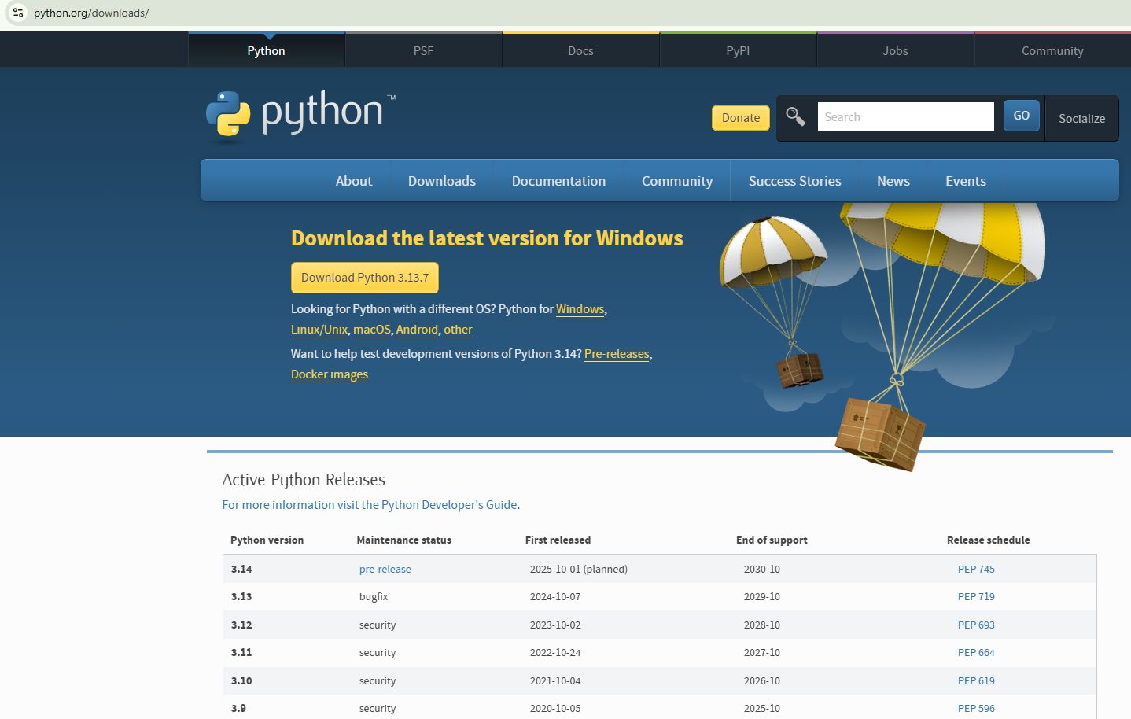
Installation

Slide 8
Running Python:
There are three different ways to start Python:
(1) Interactive Interpreter: You can enter python and start coding right away in the interactive interpreter by starting it from the command line.
C:>python
(2) Script from the Command-line: A Python script can be executed at command line by invoking the interpreter on your application, as in the following:
C:>python script.py

Slide 9
(3) Integrated Development Environment : PythonWin is the first Windows interface for Python and is an IDE with a GUI.

Slide 10
Python Identifiers:
A Python identifier is a name used to identify a variable, function, class, module or other object.
An identifier starts with a letter A to Z or a to z or an underscore (_) followed by zero or more letters, underscores and digits (0 to 9).
Python does not allow punctuation characters such as @, $ and % within identifiers.
Python is a case sensitive programming language. Thus, Manpower and manpower are two different identifiers in Python.

Slide 11
Reserved Words:
Reserved words may not be used as constant or variable or any other identifier names.
All the Python keywords contain lowercase letters only.

Slide 12
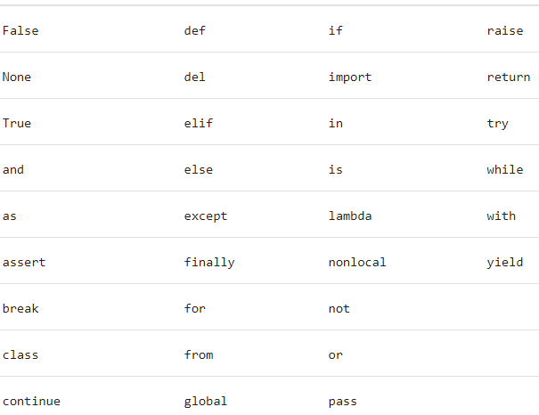
Reserved Words:

Slide 13

Lines and Indentation:
One of the first caveats programmers encounter when learning Python is the fact that there are no braces to indicate blocks of code for class and function definitions or flow control. Blocks of code are denoted by line indentation, which is rigidly enforced.
The number of spaces in the indentation is variable, but all statements within the block must be indented the same amount.
(
)
(
)

Slide 14
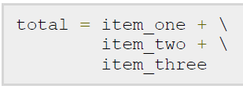
Multi-Line Statements
Statements in Python typically end with a new line.
Python does, however, allow the use of the line continuation character (\) to denote that the line should continue.

Slide 15

Multi-Line Statements
Statements contained within the [], {} or () brackets do not need to use the line continuation character

Slide 16

Quotation in Python:
Python accepts single ('), double (") and triple (''' or """') quotes to denote string literals, as long as the same type of quote starts and ends the string.
The triple quotes can be used to span the string across multiple lines.

Slide 17
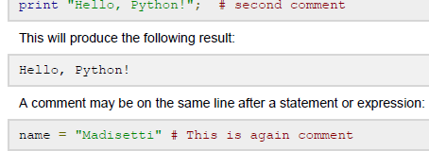
Comments in Python:
A hash sign (#) that is not inside a string literal begins a comment.
All characters after the # and up to the physical line end are part of the comment and the Python interpreter ignores them.
(
)

Slide 18
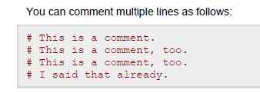

Slide 19
Python variable
Variables are nothing but reserved memory locations to store values.
when you create a variable you reserve some space in memory.
Based on the data type of a variable, the interpreter allocates memory and decides what can be stored in the reserved memory.
Therefore, by assigning different data types to variables, you can store integers, decimals or characters in these variables.

Slide 20
Assigning Values to Variables:
Python variables do not have to be explicitly declared to reserve memory space.
The declaration happens automatically when you assign a value to a variable.
The equal sign (=) is used to assign values to variables.

Slide 21
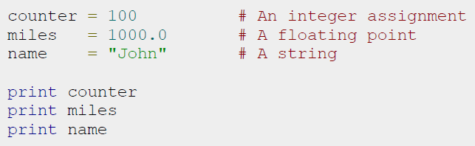
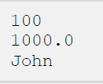
Assigning Values to Variables:
(
)
(
)
(
)

Slide 22


Multiple Assignment:
Python allows you to assign a single value to several variables simultaneously
Here, an integer object is created with the value 1, and all three variables are assigned to the same memory location.
You can also assign multiple objects to multiple variables.

Slide 23
Standard Data Types:
The data stored in memory can be of many types.
For example, a person's age is stored as a numeric value and his or her address is stored as alphanumeric characters.
Python has various standard types that are used to define the operations possible on them and the storage method for each of them.

Slide 24
Standard Data Types:
Python has following standard data types:
Numbers
String
List
Tuple
Dictionary
set

Slide 25
Working With Numbers
The interpreter acts as a simple calculator: you can type an expression at it and it will write the value.
Expression syntax is straightforward:
operators +, -, * and / work just like in most other languages (for example, C);
parentheses can be used for grouping.

Slide 26
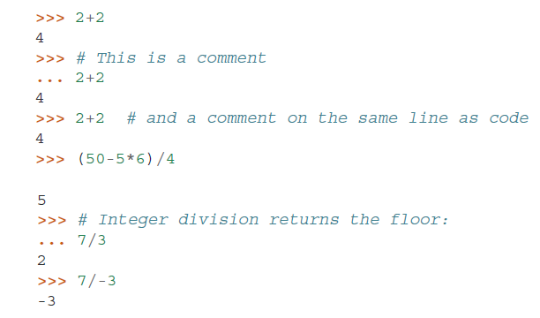
Examples

Slide 27
Python Numbers
Python supports following different numerical types
int (signed integers): positive or negative whole numbers with no decimal point.
long (long integers ): integers of unlimited size, written like integers and followed by an uppercase or lowercase L. It is not supported in Python 3.x version.
float (floating point real values) :represent real numbers and are written with a decimal point dividing the integer and fractional parts.
Floats may also be in scientific notation, with E or e indicating the power of 10 (2.5e2 = 2.5 x 10² = 250).
complex (complex numbers) : are of the form a + bJ, where a and b are floats and J (or j) represents the square root of -1 (which is an imaginary number).
The real part of the number is a, and the imaginary part is b.

Slide 28

Working With Numbers
The equal sign (’=’) is used to assign a value to a variable. Afterwards, no result is displayed before the next interactive prompt:

Slide 29
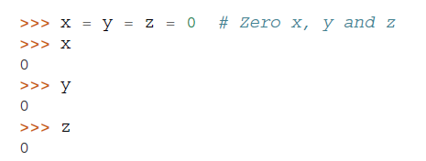
Working With Numbers
A value can be assigned to several variables simultaneously:

Slide 30
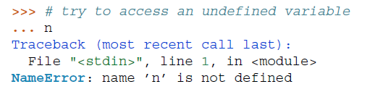
Working With Numbers
Variables must be “defined” (assigned a value) before they can be used, or an error will occur:

Slide 31

Working With Numbers
There is full support for floating point; operators with mixed type operands convert the integer operand to floating point:
a+bj
0+1j

Slide 32
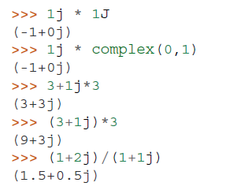
Working With Numbers
Complex numbers are also supported;
imaginary numbers are written with a suffix of j or J.
Complex numbers with a nonzero real component are written as (real+imagj), or can be created with the complex(real, imag) function.

Slide 33
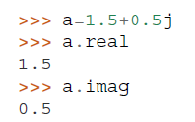
Working With Numbers
Complex numbers are always represented as two floating point numbers, the real and imaginary part.
To extract these parts from a complex number z, use z.real and z.imag.

Slide 34
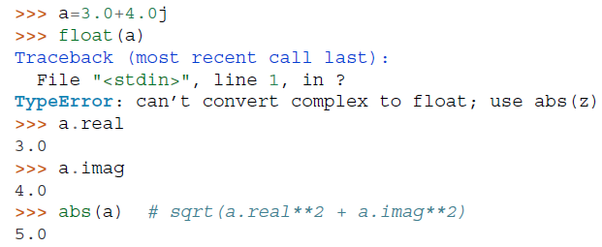
Working With Numbers
The conversion functions to floating point and integer (float(), int() and long()) don’t work for complex numbers — there is no one correct way to convert a complex number to a real number.
Use abs(z) to get its magnitude (as a float) or z.real to get its real part.

Slide 35


Mathematical Functions
abs() : The method abs() returns absolute value of x - the (positive) distance between x and zero.
Syntax
Example

Slide 36

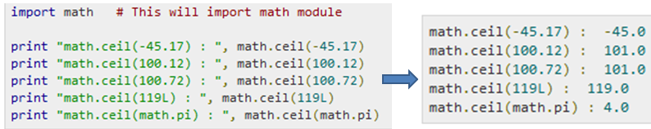
Mathematical Functions
ceil() : The method ceil() returns ceiling value of x - the smallest integer not less than x.
Syntax
x is a numeric expression.
Example

Slide 37

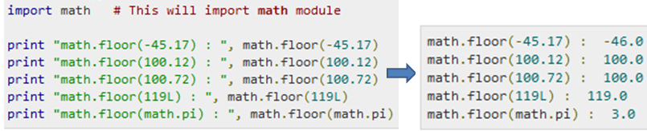
Mathematical Functions
floor() : The method floor() returns floor of x - the largest integer not greater than x.
Example

Slide 38
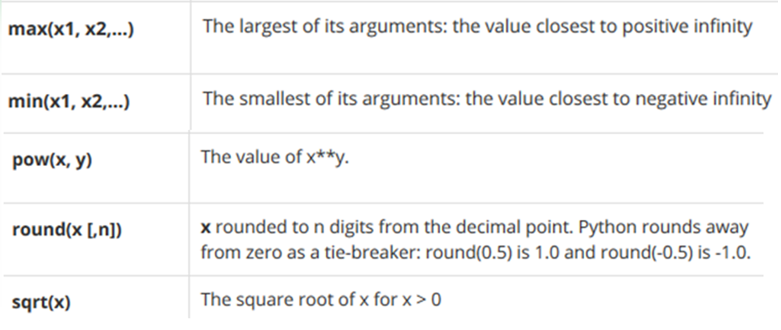
Mathematical Functions

